Slide 1
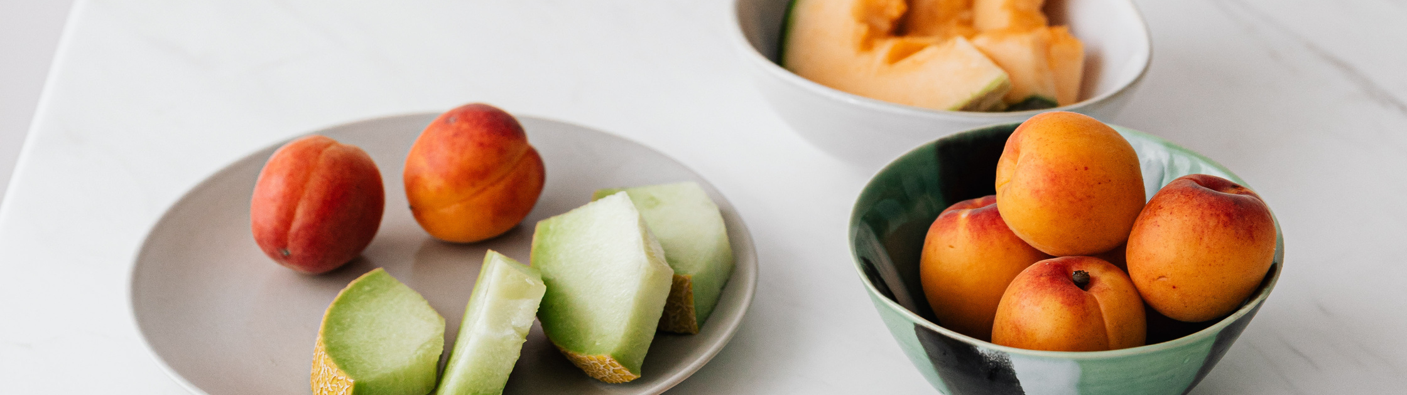
Project 1
UK Food Trends
Abraham, Helen, Kassem & Rahmi

Slide 2

Introduction
Our presentation will look at the UK Food trends since the turn of the millennium.
We've used data from the UK government website on food and farming.
After going through all the choices between API's and Datasets we picked the UK household family food datasets. This contained detailed information on UK household purchases include statistics.
These spreadsheets are updated annually when a new edition of the ‘Family Food’ report is published.
Our aim was to identify food and drink trends as well as finding the underlying information from the data. To draw our food & drink consumption popularity.
we've provided different breakdowns within our visuals by age characteristics.

Slide 3
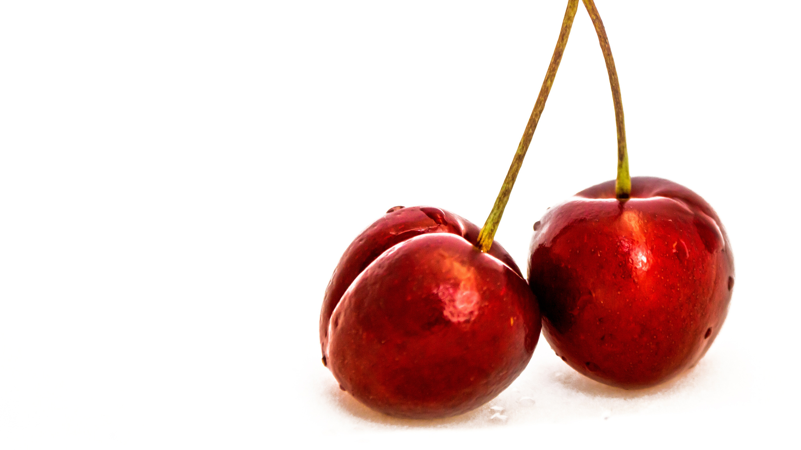
Methodology

Slide 4
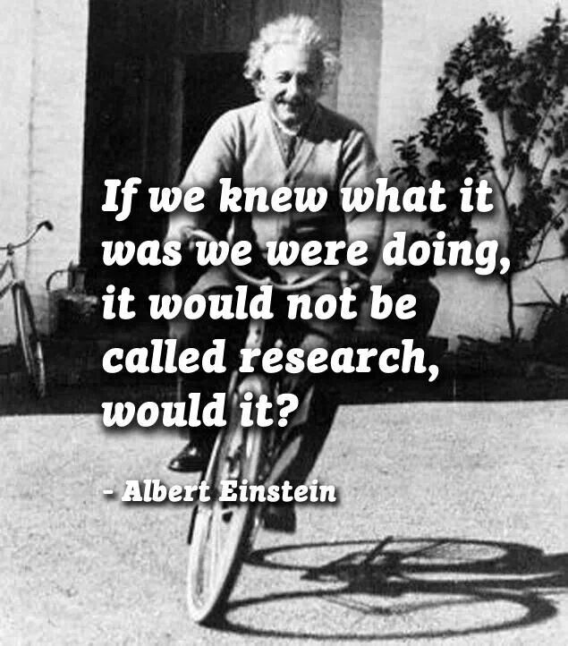

Research is formalized curiosity. It is poking and prying with a purpose
— Zorah Neal Hurtson

Slide 5
Our Methodology
We found data from UK Gov websites for Farming and food containing various information related to our area. we narrowed down to look at food trends since the turn of the century looking at popularity of food and drink by uk household at various age groups.
Initial data exploration was done to better understand and visually identify anomalies within the data as well as focus our research to which area's we wished to explore. When this process concluded we decided on our data set's but instead of picking one data set we have pooled various data sets together to which we created our data frame rather than take an already construct and available one.
The we split the questions amongst the group and produced the relevant code to give us answers to our questions.

Slide 6


The Dataset
a little background on our data set ......
11 Food Categories
23 Food Groups
169 Major Food Categories
134 Minor Food Categories

Slide 7



Slide 8
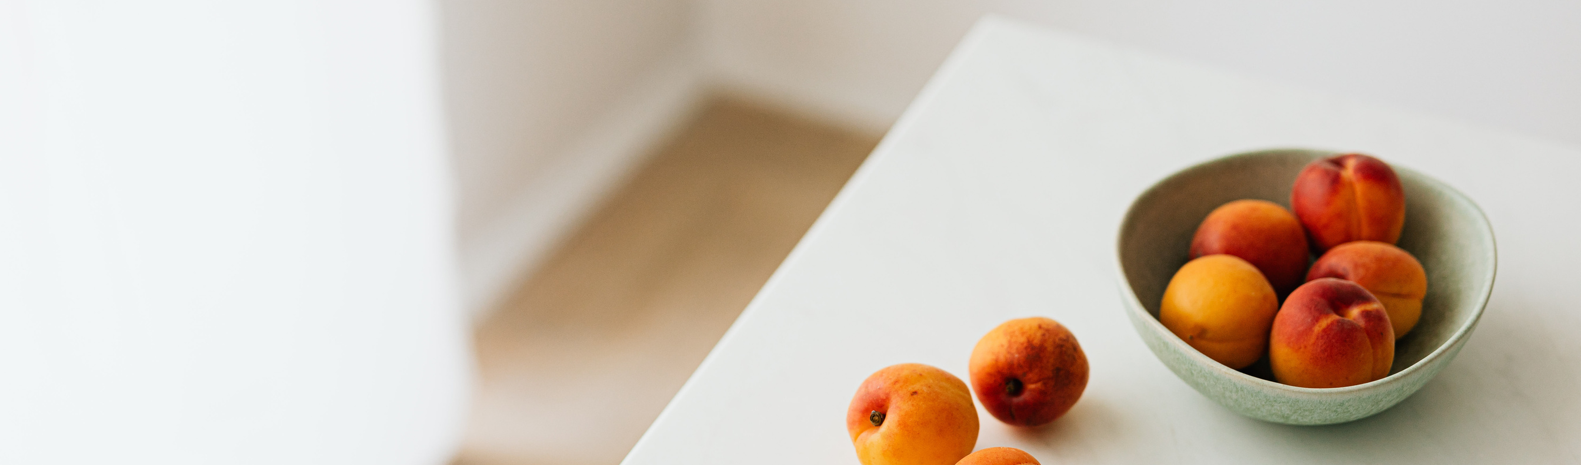
The Data & Our Findings

Slide 9
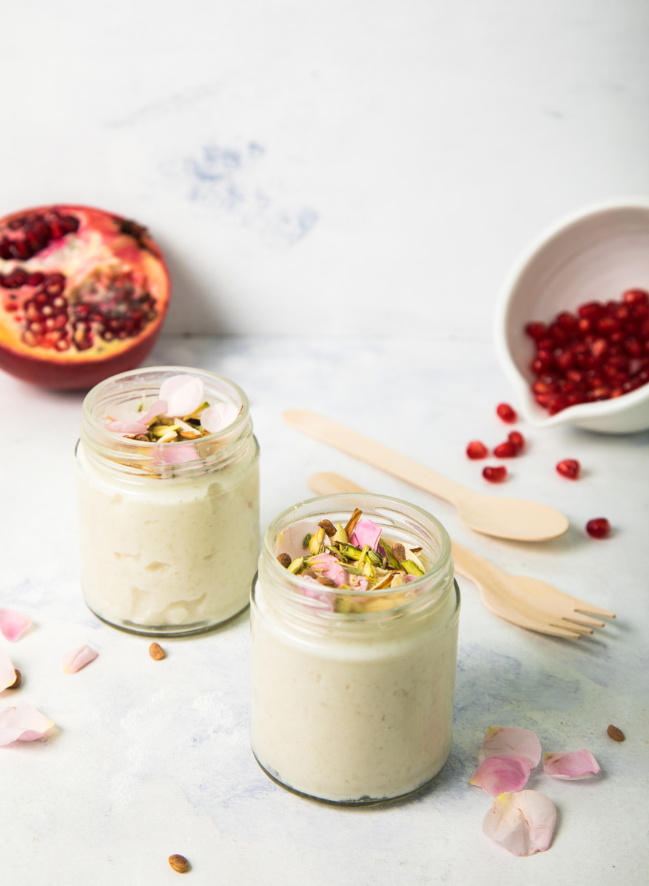
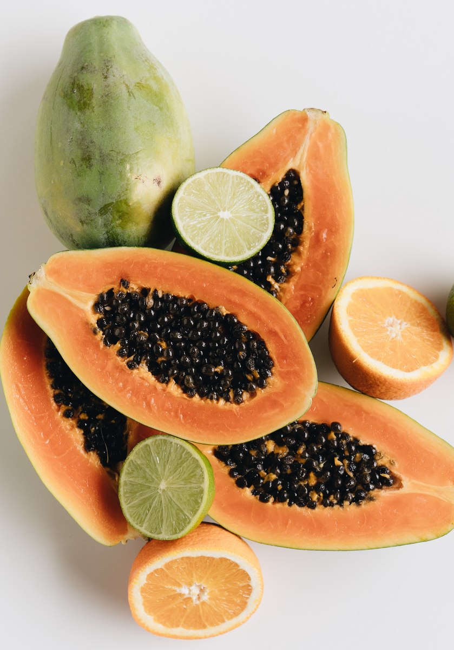
Findings - 1st Phase Food Groups
FOOD & SNACKS
DRINK
What is the most popular by all age Group.
underlying trend by age group
What is the most popular by all age Group.
underlying trend by age group

Slide 10
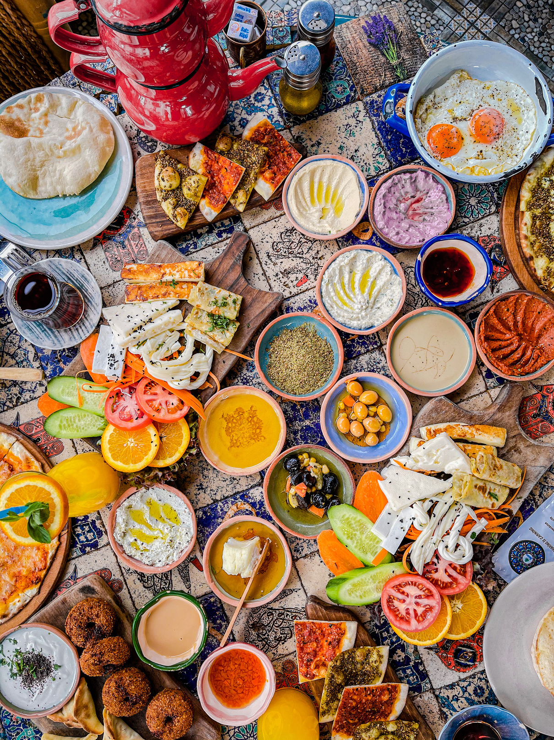
What is the most popular food & drink by consumption for all age Groups?
Use this for a photo caption.

Slide 11
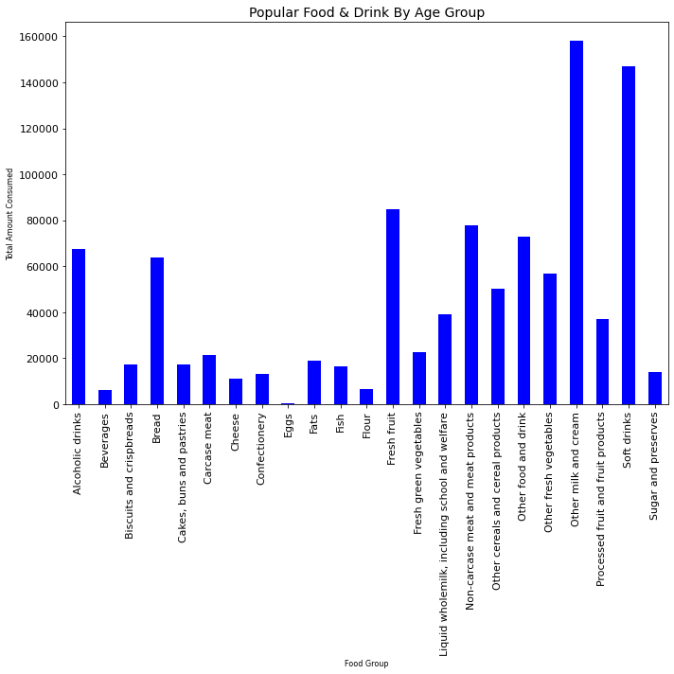

Key Points
most popular food by total average consumption per person
most popular drink by total average consumption per person
We will go deep dive further detail throughout the presentations

Slide 12
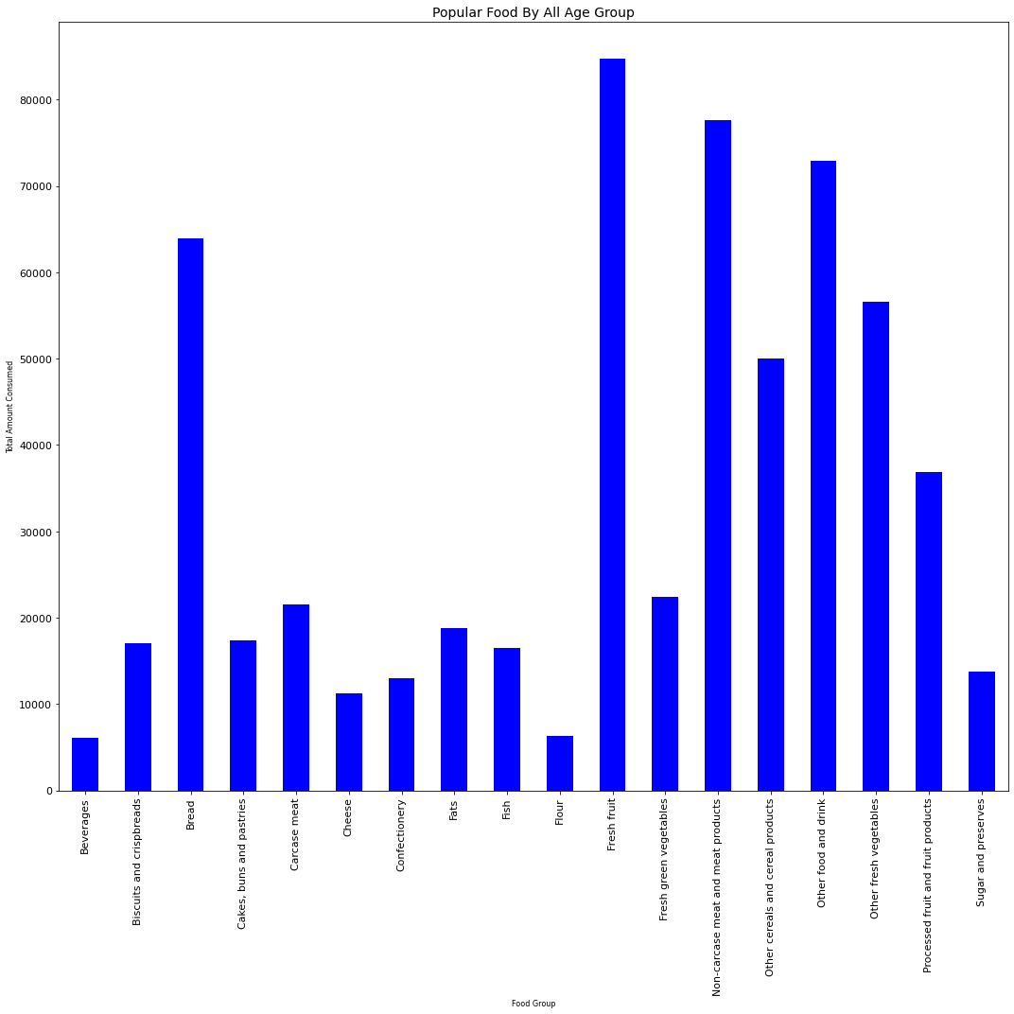
01
MOST POPULAR FOOD?
Bread, Fruit, Non Carcasses Meat & Other Food & Drink Category
02
WHAT ARE OTHER FOOD?
Mineral Water, Baby Food, Soups, Sauces, Salt & Ice Cream.
03
WHAT IS NON CARCASSED MEAT?
Liver, Bacon, Ham, poultry not in cans, Sausages
04
FRESH FRUIT
Oranges, Apples, Pears, Grapes & Bananas.
05
SPECIAL MENTION
Beverages, unit of measure & Contents (Tea, Coffee, Instant Coffee Malt Drinks, Cocoa Drinks & Takeaway Drinks.

Slide 13
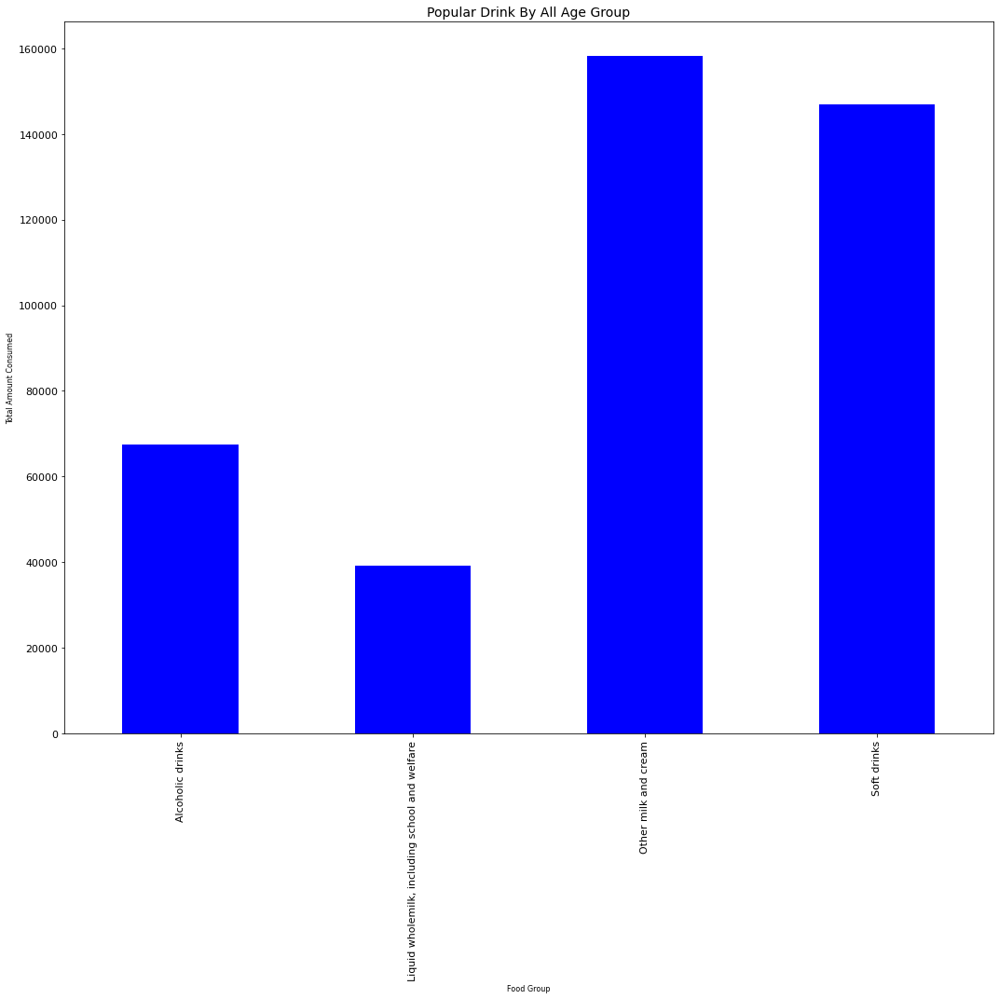
01
WHAT IS THE MOST POPULAR DRINK?
Skimmed milk (semi/ full), yogurts & other dairy deserts, Non-Dairy Milk substitutes
02
LIQUID WHOLEMILK
vs. Skimmed Milk (Part / Whole)
03
SOFT DRINK
Soft Drink 2 categories - low cal and non low cal. (April 2018)
04
ALCHOHOLIC DRINKS
Give us hope we are not a nation of alcoholics at the time of this survey data.
Write your topic or idea

Slide 14
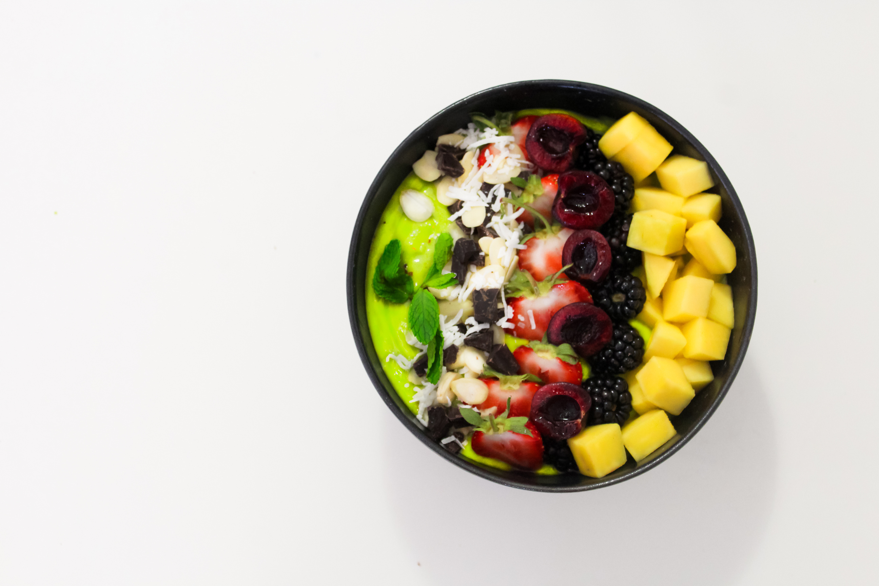
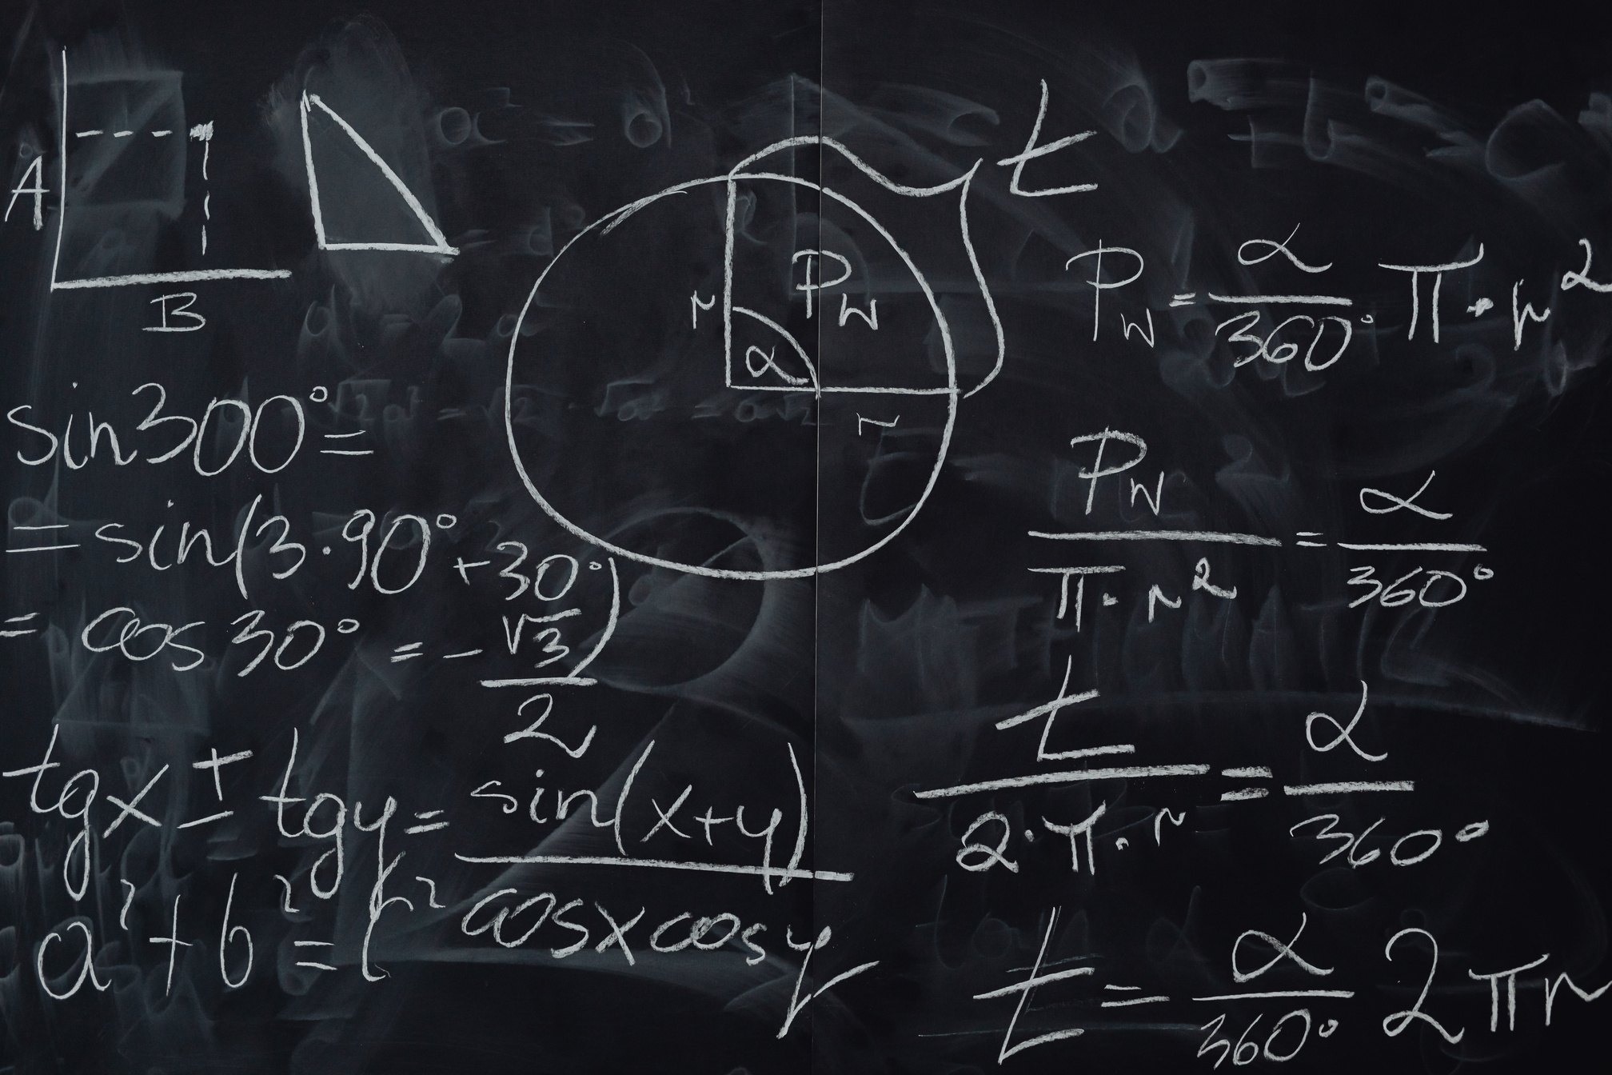
Phase 2 - Deep Dive

Slide 15
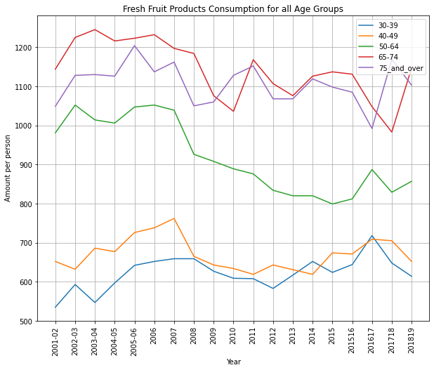

What does the data tell us.....
decline in consumption across 4/5 categories starting in 2007 and continuing till 2010.
2015 for 50-64

Slide 16


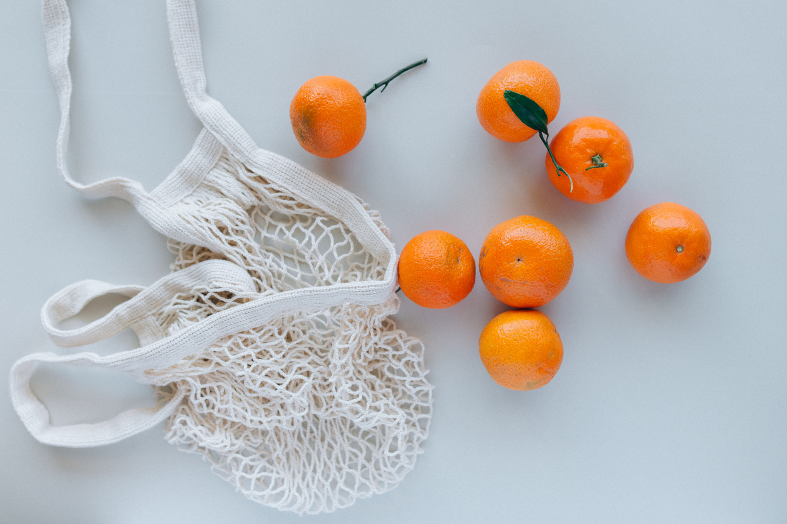
Fresh Fruit
30-39 & 40-49
65-74 & 75+
50-64
have similar attitude on average to fruit consumption as they are close to each other consumption level. (600-700g per week)
Are the highest consumer of fruit. (Health Benefits?/ overlay info with health data in future studies?)
from 2007 had a steady decline in fruit consumption till 2015, does the economy influence this demographic more than others? or did the recession change habits

Slide 17
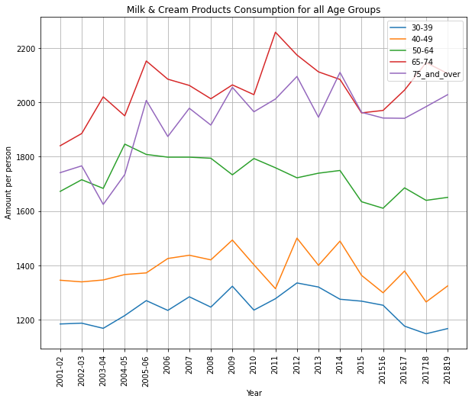
Let talk about Drink.........
Focusing on our most popular category….Ranking of the age groups.

Slide 18
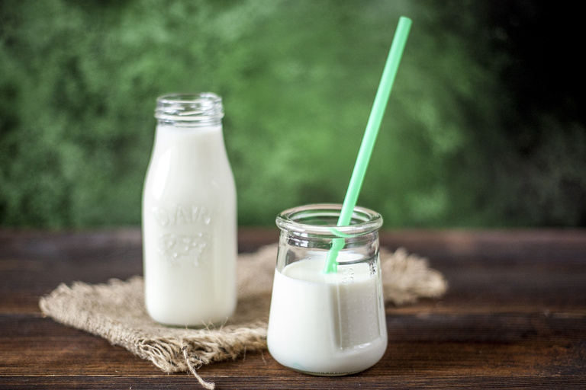
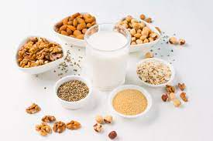
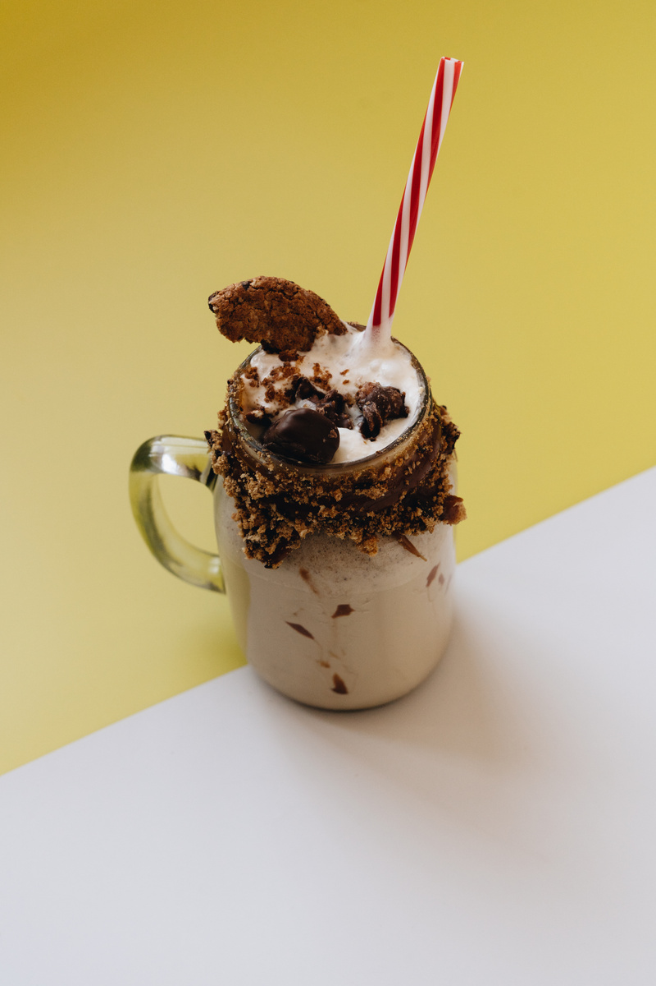
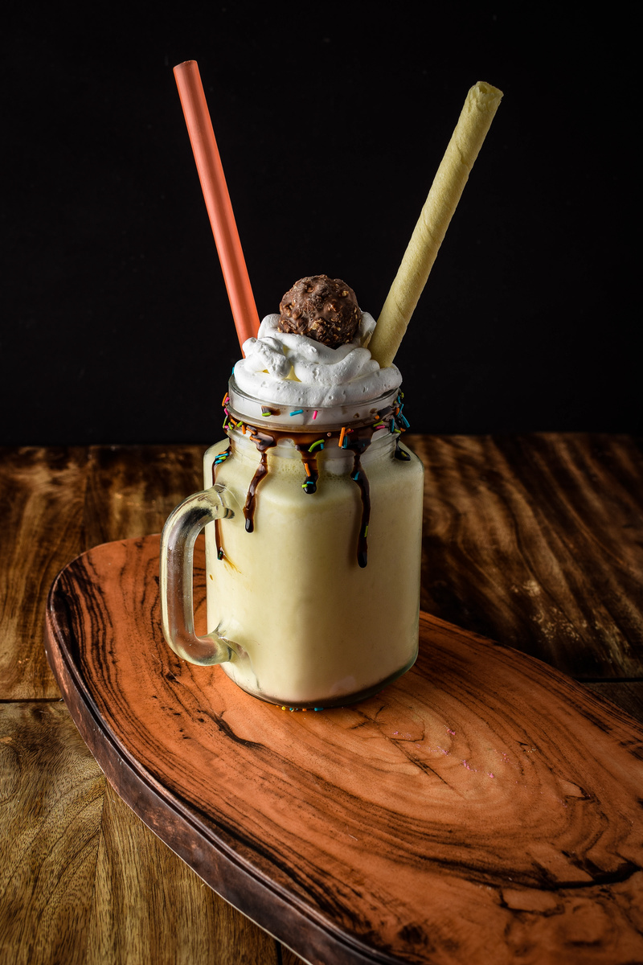
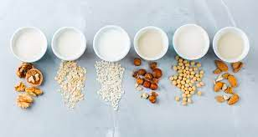
Milk & Cream Drinks
ALL AGE GROUPS
65-74 & 75+
50-64
the graph also tells us unlike fruit the economic condition don't have the same level of influence in consumption habits.
Upward Trend in milk consumption, peaking at 2.2 liters per week in 2011.
3rd highest consumer of milk staying stable in that position between 1.6-1.8 liters per week.

Slide 19
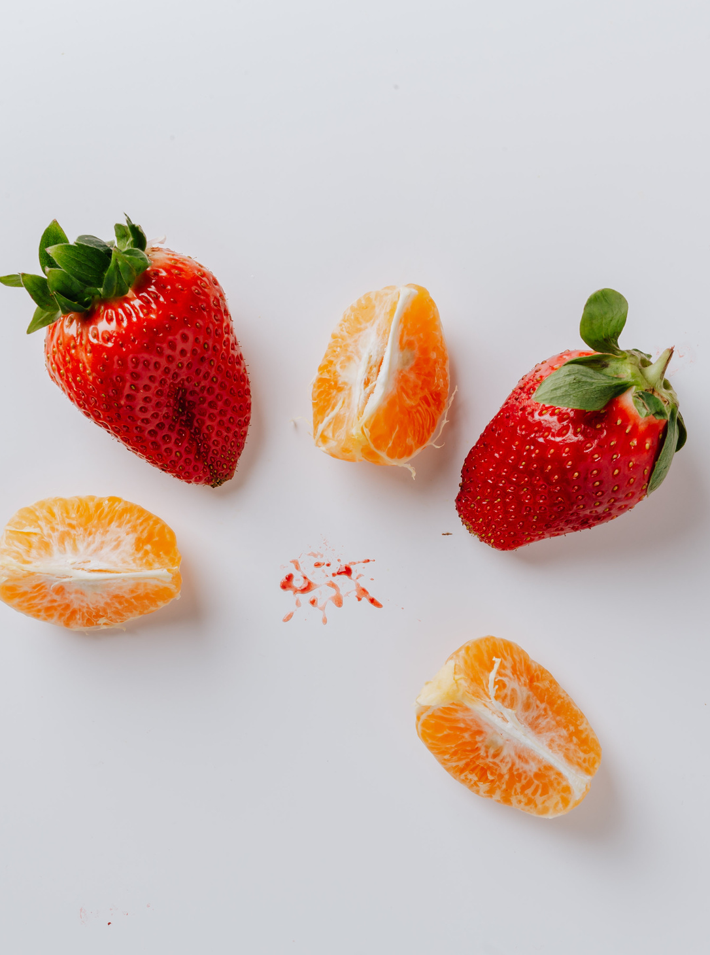
Rahmi - Level 2

Slide 20
Level 2
Minor food code – any surprises?

Slide 21
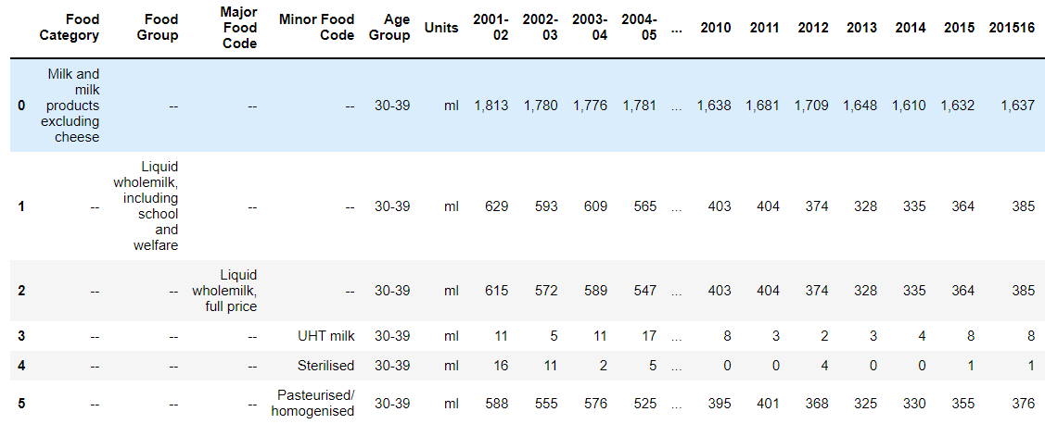
Category choice

Slide 22
01
30-39
02
40-49
5 Age groups
03
50-64
04
65-74
05
75 and over

Slide 23
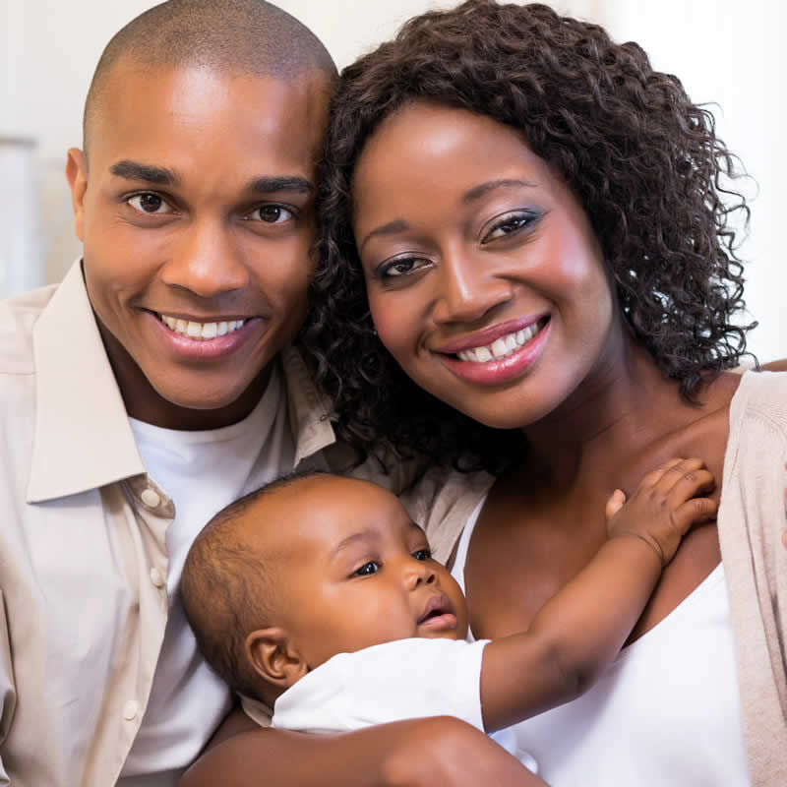
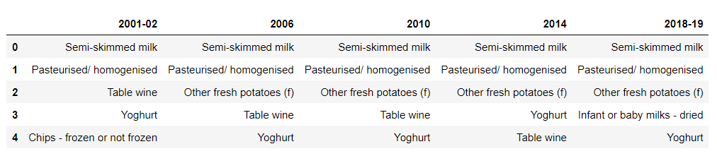
Age Group 30-39
Baby milks popularity in 2018-19, one-off or trend?

Slide 24
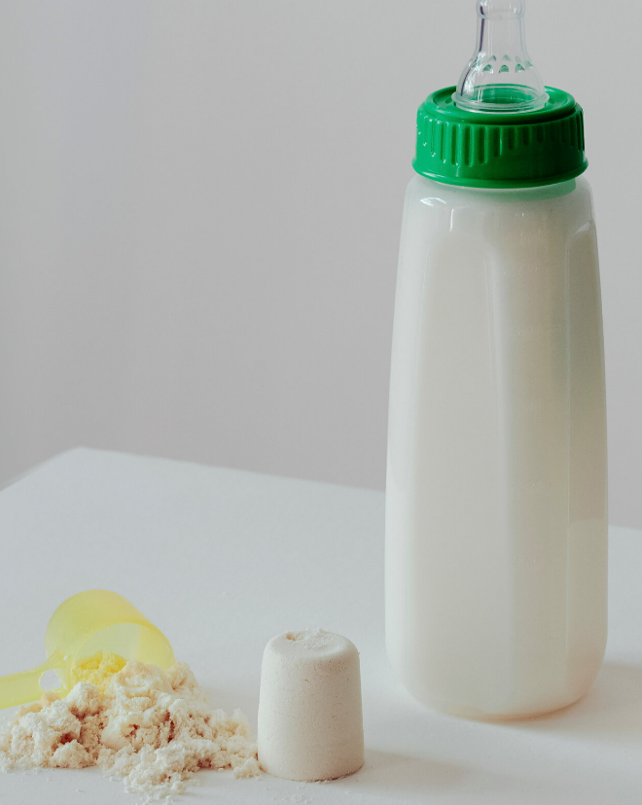
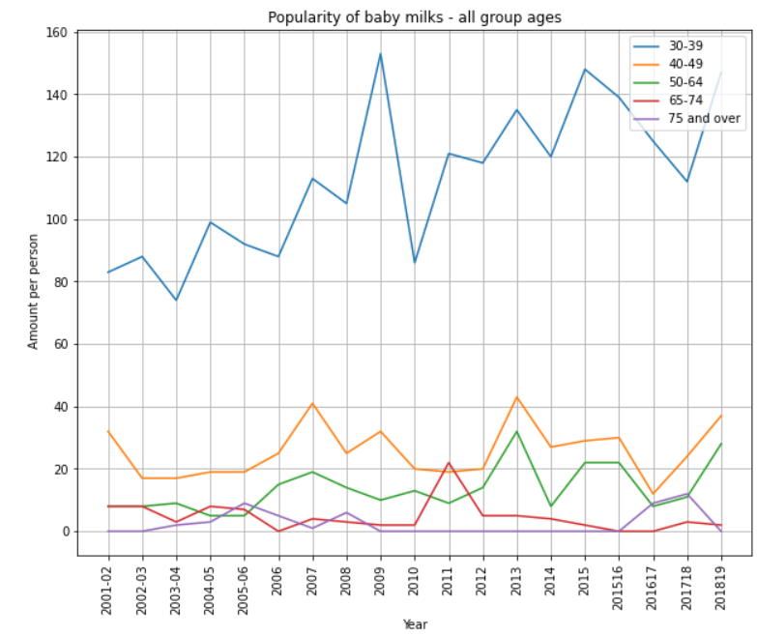
The popularity of baby milks
Increased from 83 to 147 ml per person in the period 2001 – 2019
A huge 77% jump

Slide 25
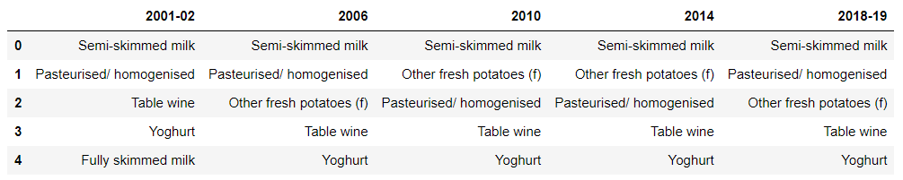
Age Group 40-49

Slide 26

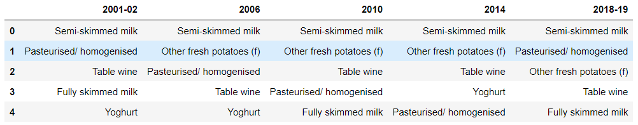
Age Group 50-64

Slide 27
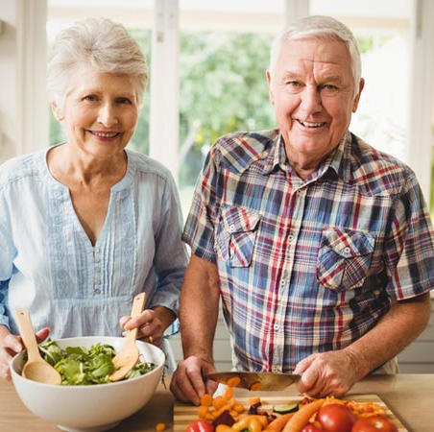
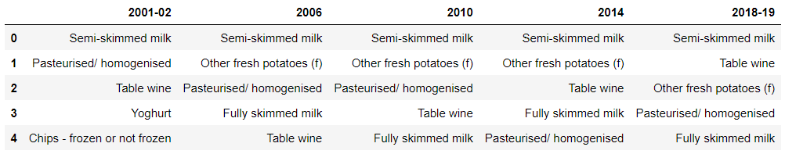
Age Group 65-74

Slide 28
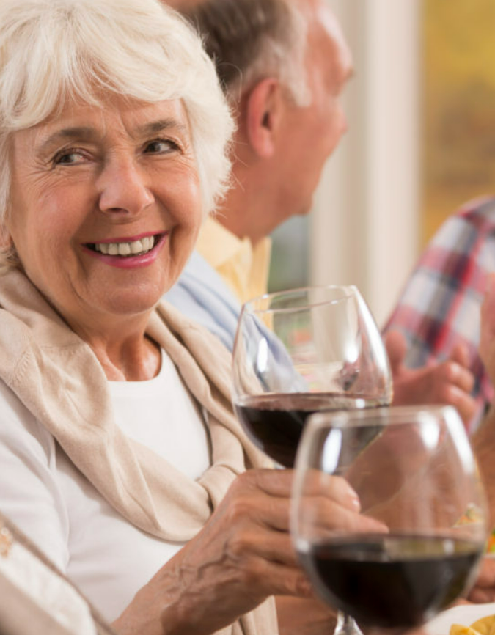
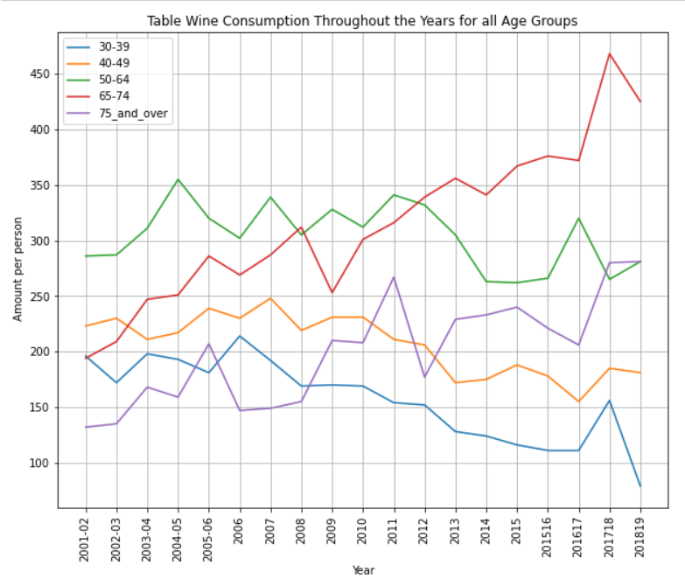
65-74: +119%
75 and over: +112%

Slide 29
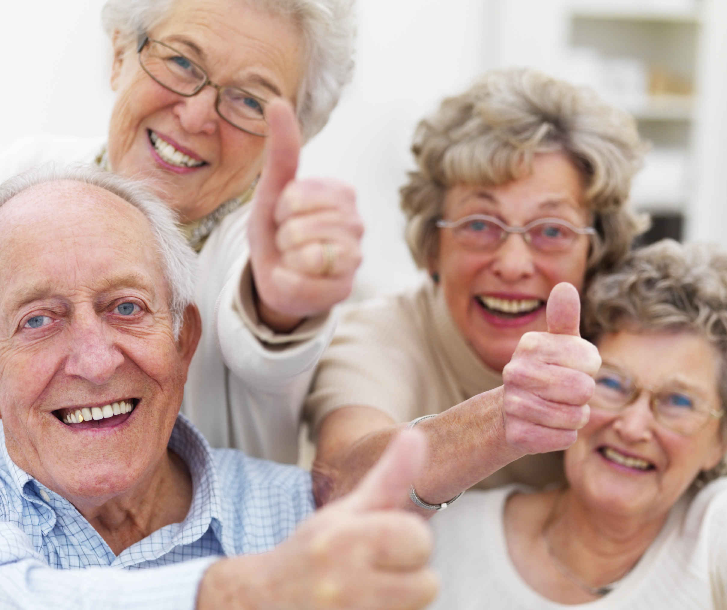
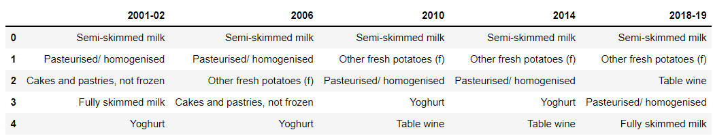
Age group 75 and over

Slide 30
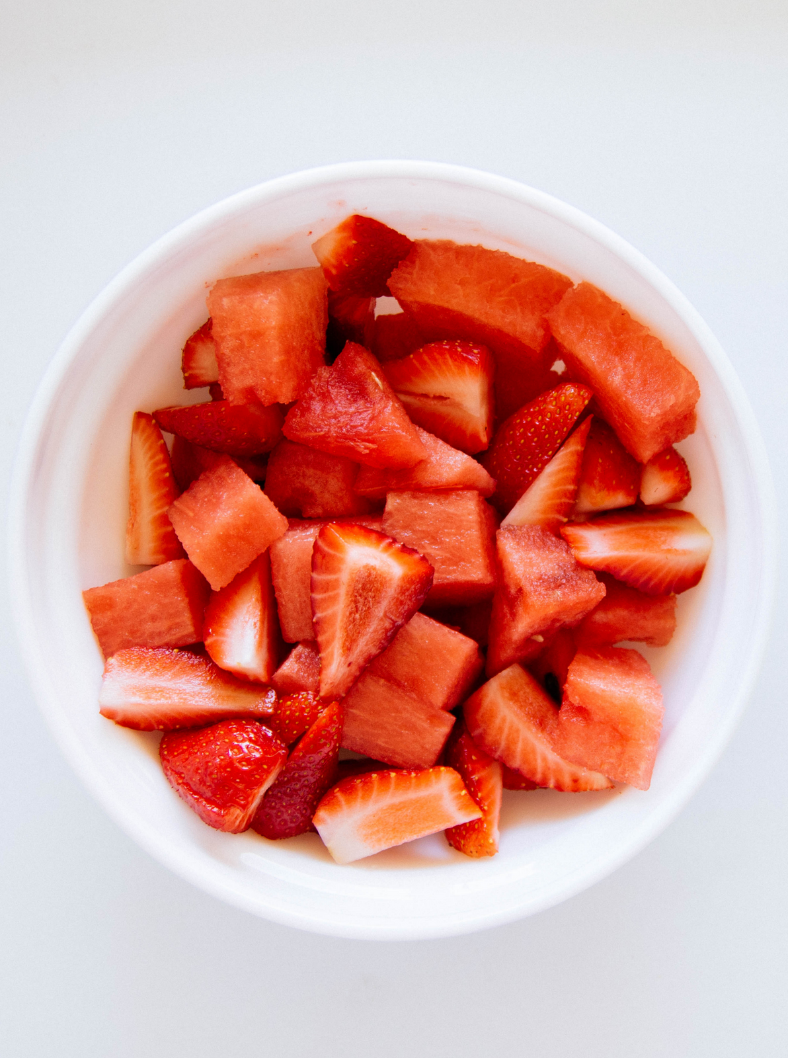
Helen - Level 3
Briefly elaborate on what you want to discuss.

Slide 31
Write your topic or idea
Briefly elaborate on what you want to discuss.
125
100
75
50
25
0
Item 1
Item 2
Item 3
Item 4
Item 5

Slide 32
Item 5
20%
Item 1
20%
Write
your topic or idea
Item 4
20%
Item 2
20%
Briefly elaborate on what
you want to discuss.
Item 3
20%

Slide 33
Write
your topic or idea
ADD A
MAIN POINT
30%
ADD A
MAIN POINT
Briefly elaborate on what
you want to discuss.
60%
ADD A
MAIN POINT
90%

Slide 34
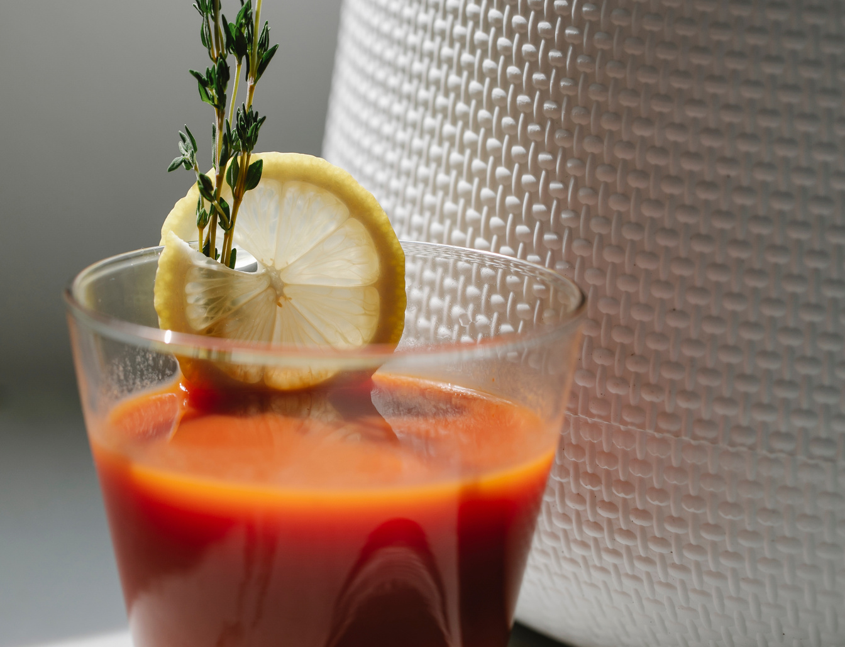
Write your topic or idea
Briefly elaborate on what you want to discuss.

Slide 35
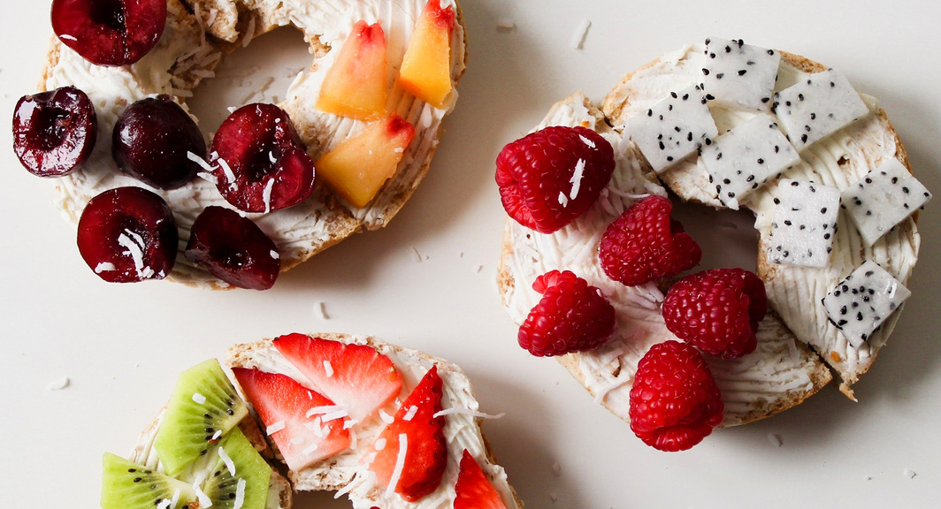
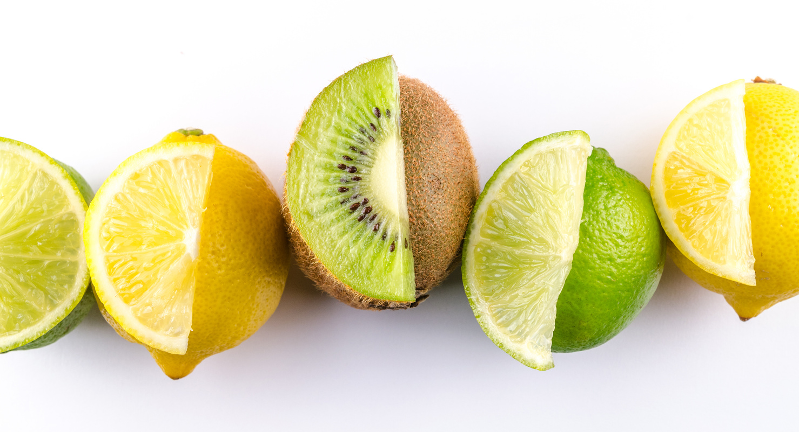
Write your
topic or idea
Briefly elaborate on what you want to discuss.

Slide 36
01
ADD A MAIN POINT
Briefly elaborate on what
you want to discuss.
Write your topic or idea
02
ADD A MAIN POINT
Briefly elaborate on what
you want to discuss.

Slide 37
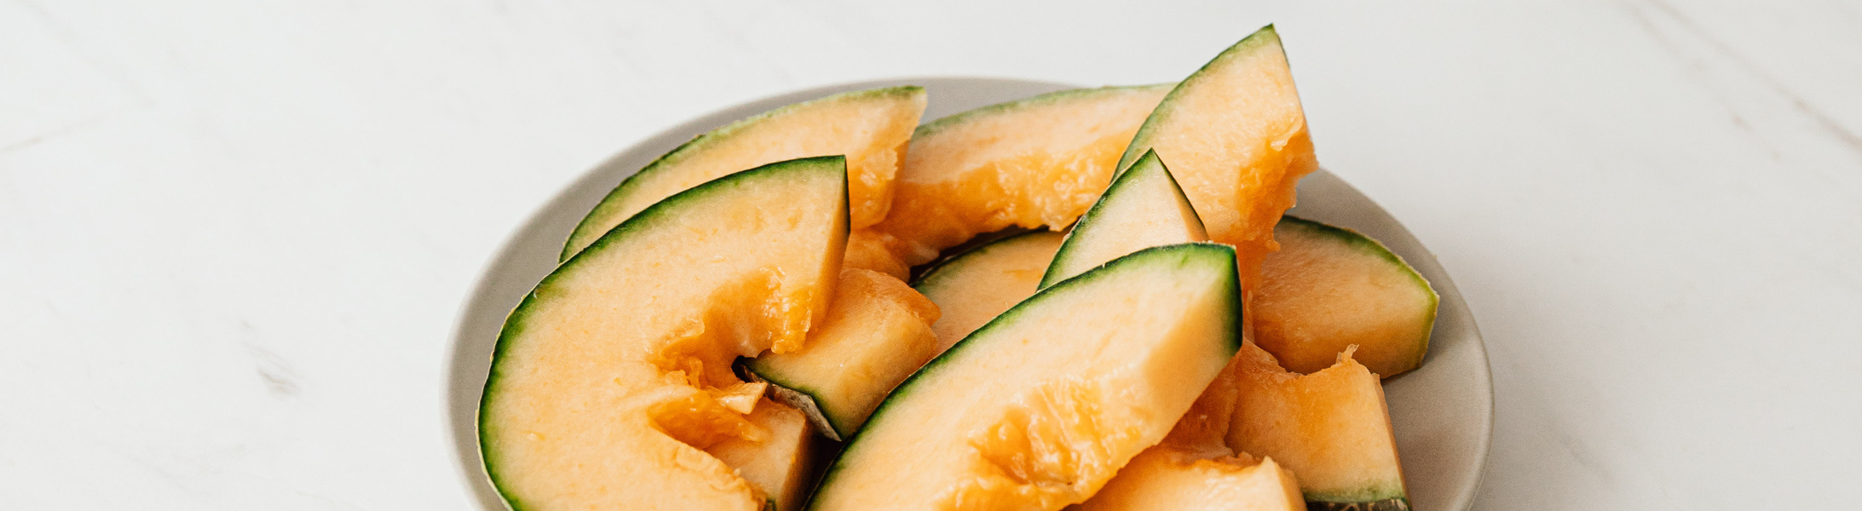
Write your topic or idea
Briefly elaborate on what you want to discuss.

Slide 38
Write
your topic or idea
3 OUT OF 6
Briefly elaborate on what you want to discuss.
5 OUT OF 6
Briefly elaborate on what you want to discuss.

Slide 39
Add a section header

Slide 40
Write your topic or idea
Briefly elaborate on what you want to discuss.
50
40
30
20
10
0
Item 1
Item 2
Item 3
Item 4
Item 5

Slide 41
Write your topic or idea

Slide 42
Write your topic or idea
01
02
03
04
ADD A MAIN POINT
ADD A MAIN POINT
ADD A MAIN POINT
ADD A MAIN POINT
Briefly elaborate on what you want to discuss.
Briefly elaborate on what you want to discuss.
Briefly elaborate on what you want to discuss.
Briefly elaborate on what you want to discuss.

Slide 43
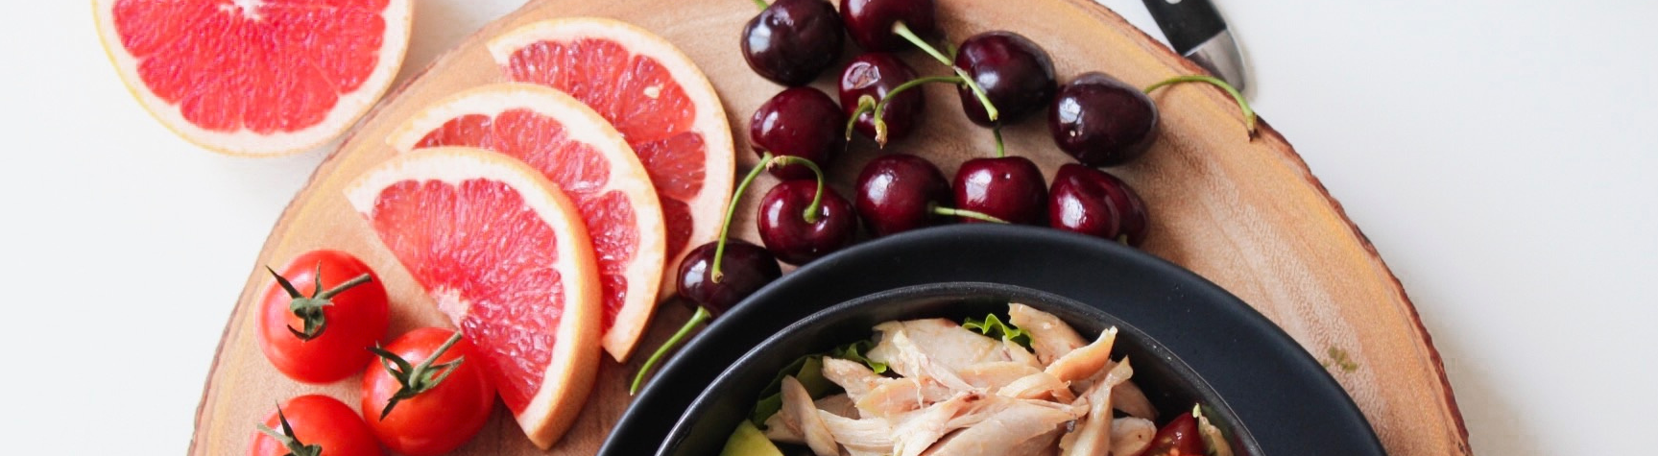
Write your topic or idea
Briefly elaborate on what you want to discuss.

Slide 44
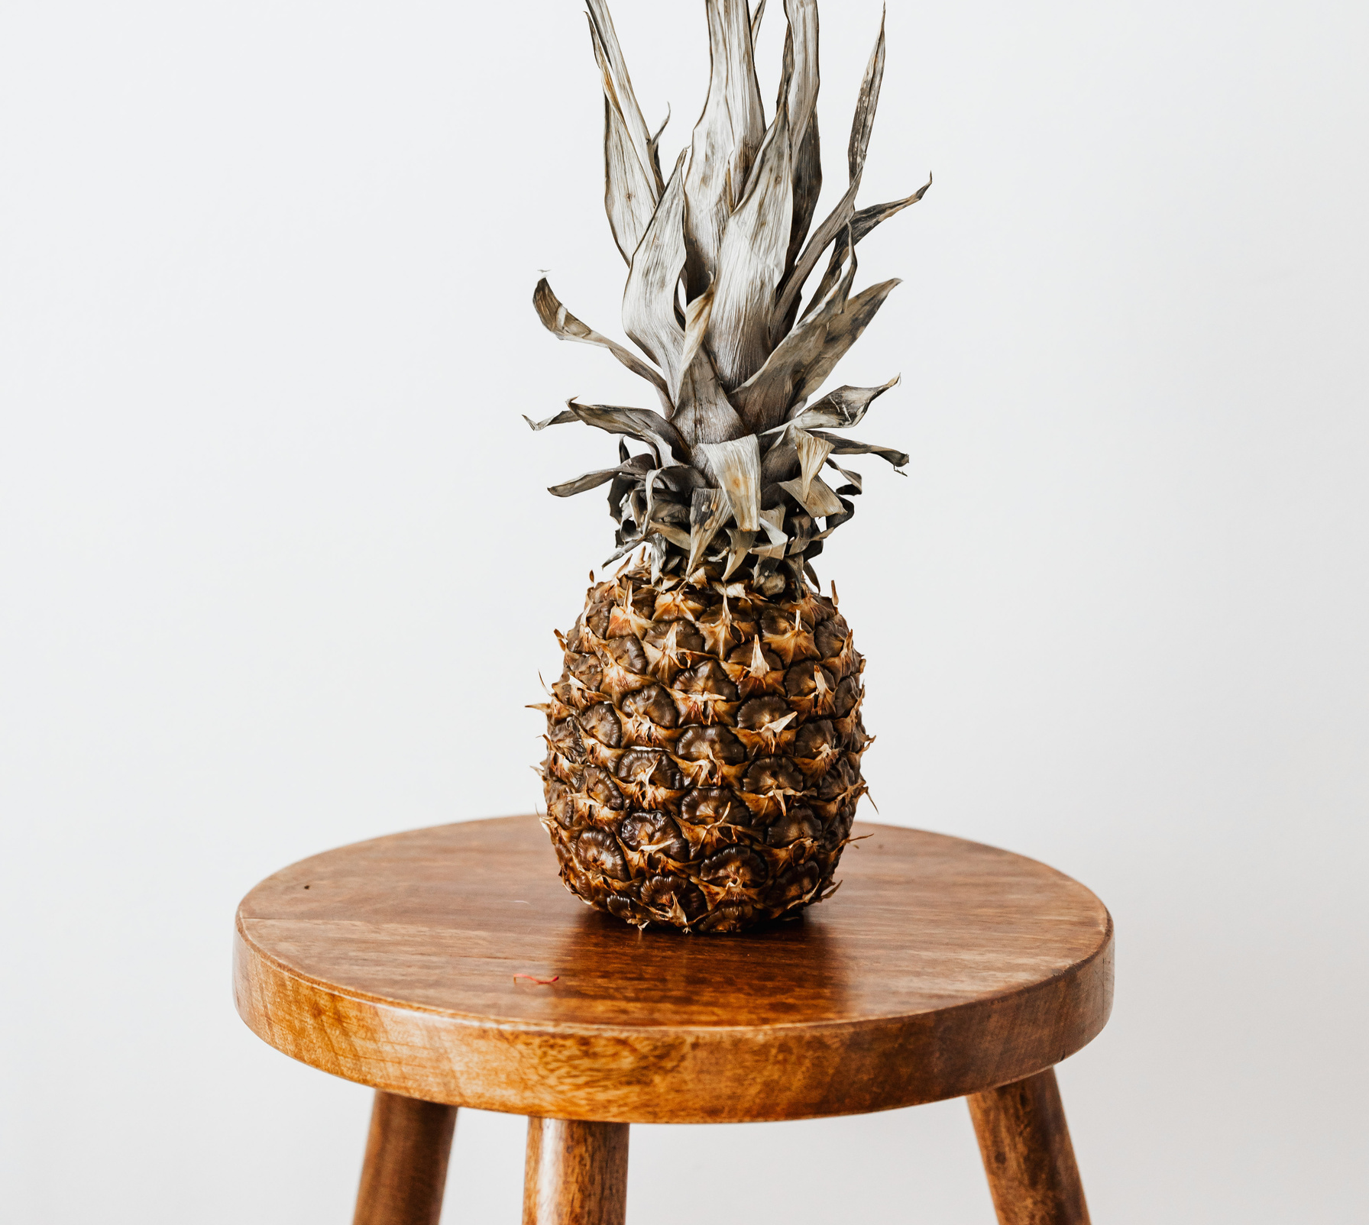
Thank You
Abraham, Helen, Kassem & Rahmi

Slide 45
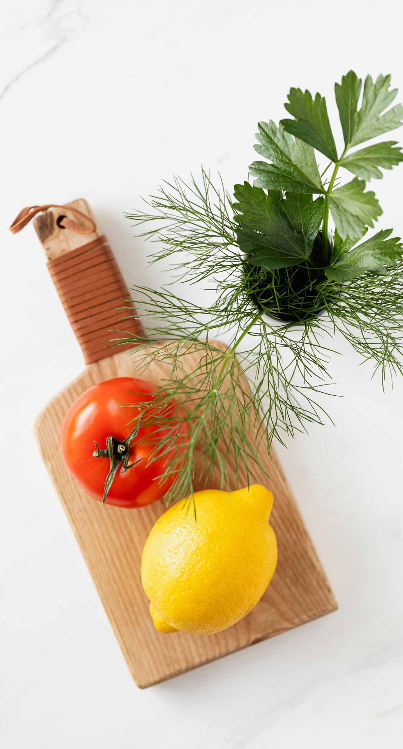
THE FUTURE BELONGS TO THOSE WHO BELIEVE IN THE BEAUTY OF THEIR DREAMS.
— Eleanor Roosevelt

Slide 46






























Free Resources
Use these elements
in your Canva presentation.

Slide 47
Write your topic or idea
01
02
03
ADD A MAIN POINT
ADD A MAIN POINT
ADD A MAIN POINT
Briefly elaborate on what
you want to discuss.
Briefly elaborate on what
you want to discuss.
Briefly elaborate on what
you want to discuss.

Slide 48
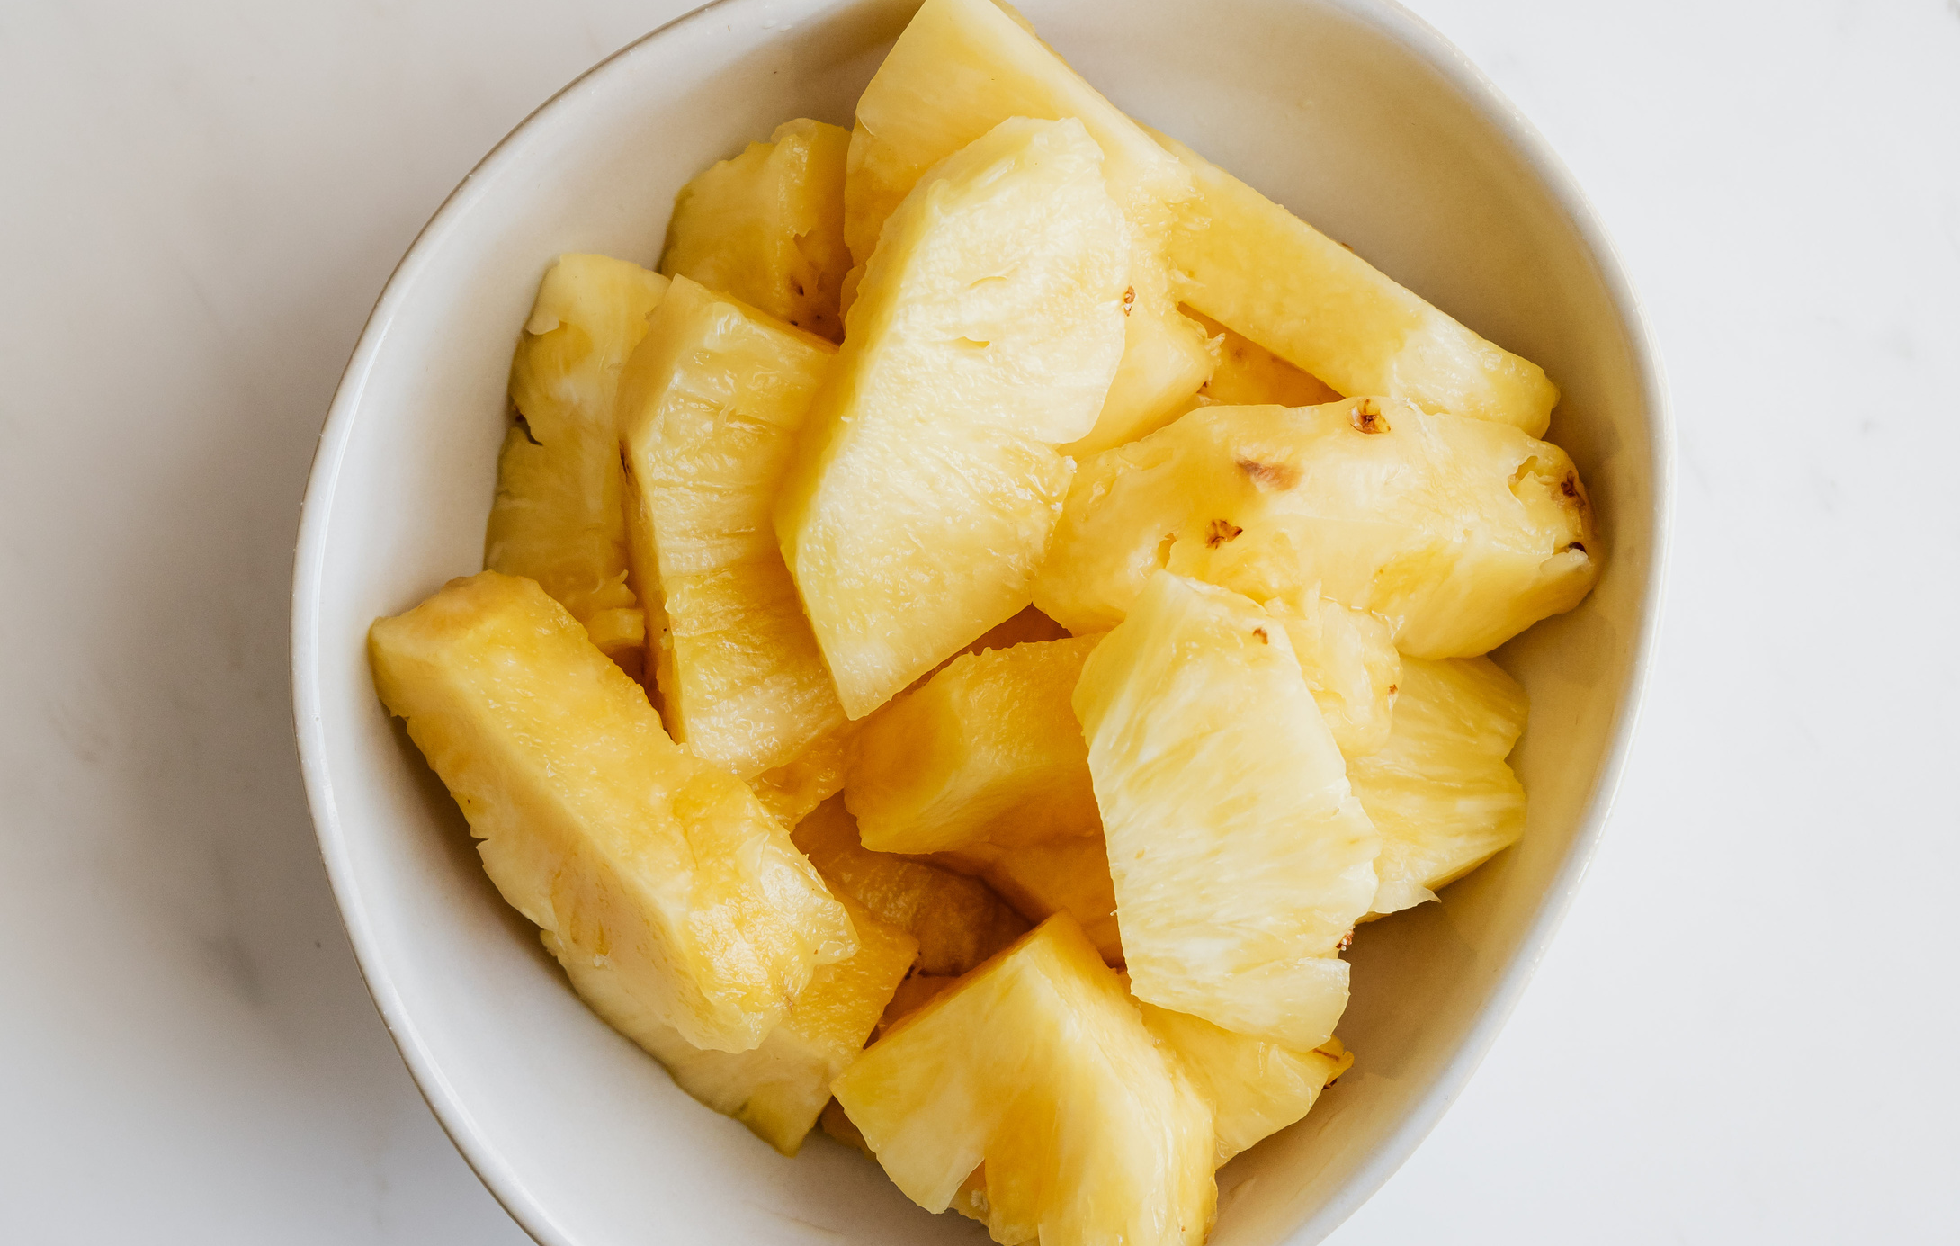
Use this for a photo caption.

Slide 49
Write your topic or idea
Briefly elaborate on what you want to discuss.

